Slide 1
Git Repositories
Sharing code using GitHub

Slide 2
Overview
What is GitHub?
Sharing repositories
User workflows
Git pull
Merge conflicts

Slide 3

What is GitHub?
GitHub is an open source cloud based hosting platform at: https://github.com/
Use Git to connect
GitHub account requires an email and password
Repositories can be created, cloned and edited

Slide 4
Sharing repositories
A repository can be shared with others
Copies using the clone command
Git clone https://github.com/NewcastleRSE-Training/intro-to-version-control.git
Repository recreated it in a local directory
Open for local file changes
Local changes can then be committed and pushed back

Slide 5
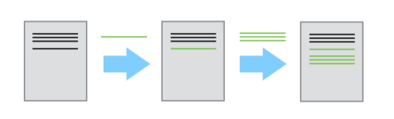
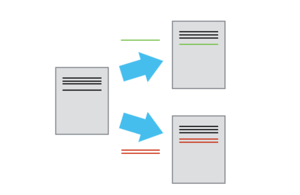
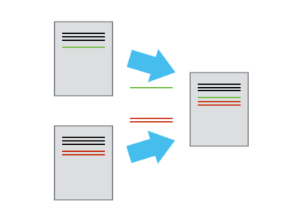
Git workflow
User 1 changes
First user makes successive changes, which are tracked
Second user gets a copy of the original and makes their own changes
Changes from both sides are finally merged in the remote repository
User 2 changes
Final document contains all changes

Slide 6
Working with others
When a repository is shared..
Users should always attempt a pull before pushing file changes: git pull
Pull combines git fetch and git merge
A pull will get any new changes
Pull updates the local working directory

Slide 7
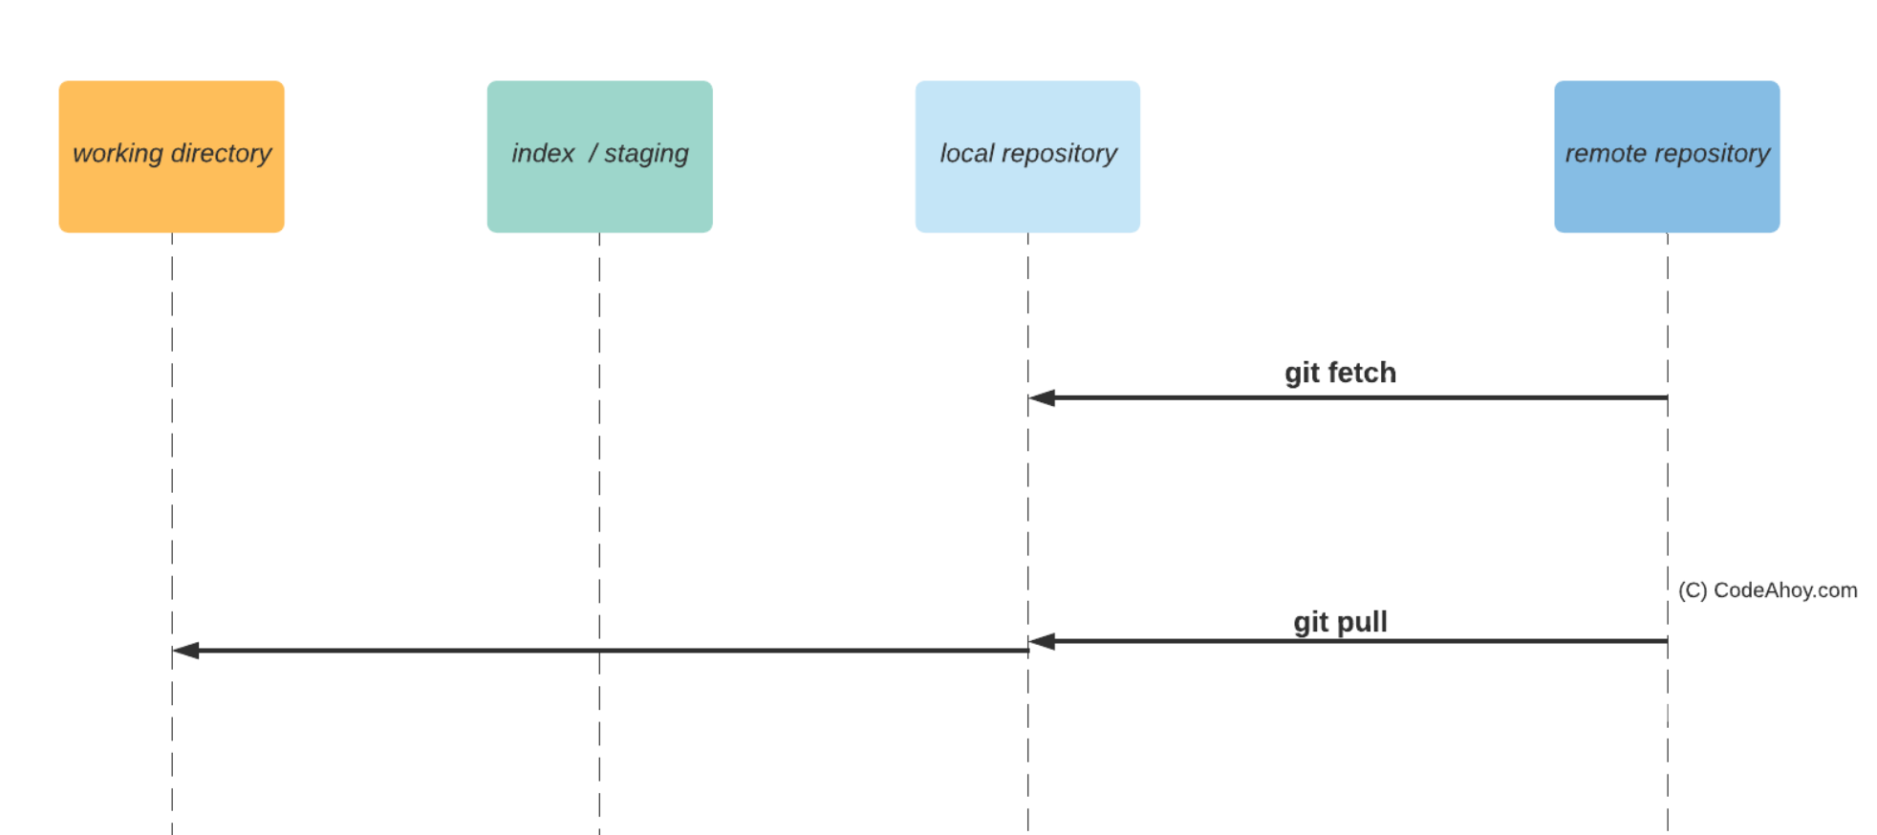

Slide 8
Merge conflicts
If the same file has been changed by another user, there may be a conflict
This may require a local manual merge
Git GUIs are useful to manage merge conflicts
Otherwise, Git automatically merges the work of multiple users in the repository

Slide 9
Useful links
GitHub help
https://help.github.com/en/github
Git documentation
https://git-scm.com/docs
Branching tutorial
https://learngitbranching.js.org/

